Slide 1
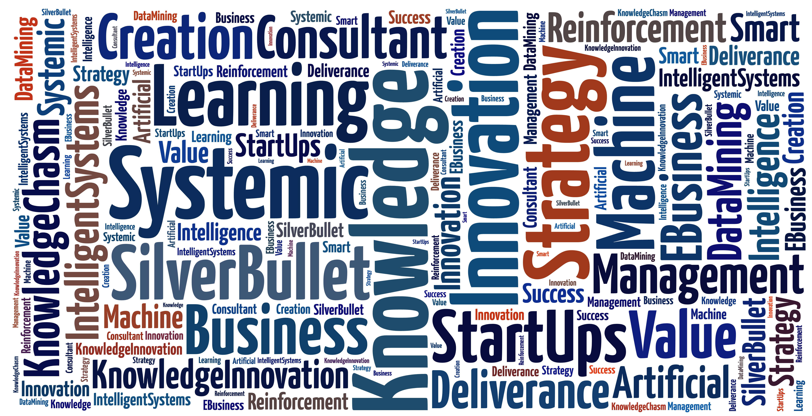
Machine Learning Workshop
www.iknowlation.com

Slide 2
Thank You

Slide 3
We are hiring
(Fulltime & interns – Ph.D. Researcher in ML)
Contact:
dnyaneshwar@iknowlation.com
https://github.com/dewadkar/rdata/

Slide 4
Revise Day 1 & 2

Slide 5
R & Python

Slide 6
agenda
Clustering – Hierarchical Clustering
TS Forecasting using – Tensor flow
Evaluation

Slide 7
Thank You

